Slide 1

OM₁
OM_{i}
OM₂
WHONDRS 2019 FTICR-MS data
OM₃
OMs’ elemental compositions
C_{a}H_{b}N_{c}O_{d}P_{e}S_{f}
Thermodynamic “$λ$” model
Colored: condition-specific OM molecular signatures
Distributed sample properties
Frequency
Thermodynamic properties
Thermodynamic properties
Black: all species
Data-driven modeling
% Occupancy
Condition-specific OM molecular signatures
Frequency
Thermodynamic properties

Slide 3

OMs’ elemental compositions
Thermodynamic
“$λ$” model
OM₁
C_{a}H_{b}N_{c}O_{d}P_{e}S_{f}
OM₂
OM_{i}
OM₃
Hypothesis:
OM metabolomics data contain molecular-level signatures of condition-specific biogeochemistry that are identifiable through advanced data-driven modeling techniques.
Distributed sample properties
Frequency
WHONDRS 2019 FTICR-MS data
Thermodynamic properties
Thermodynamic
properties
Condition-specific data classification
OM molecular signatures
Surface
Biogeochemical
conditions
Data signatures
Sediment
…
Frequency
Thermodynamic properties
Data-driven technique identifies signatures that govern the data.

Slide 5
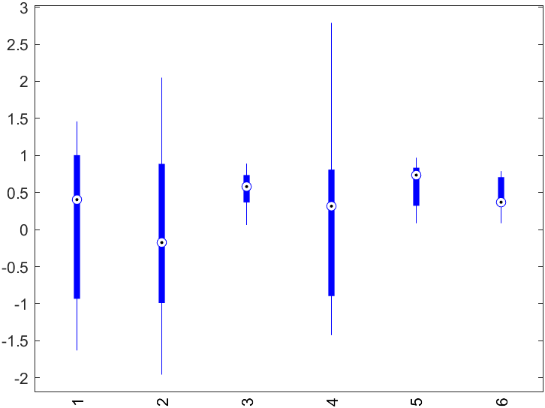
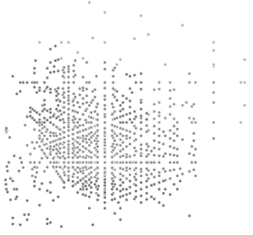
Data signatures
Frequency
Thermodynamic properties
Distributed sample properties
Frequency
Predicted ER
OM molecular signatures
Thermodynamic properties
Experimental ER
Distribution of OM molecular signatures
OM molecular signatures across various conditions
Thermodynamic properties
H:C
O:C
Environmental conditions

Slide 6
Distribution of OM molecular signatures
Distribution of OM molecular signatures
Frequency
Satellite
Core
Thermodynamic properties
Thermodynamic properties
Core
Satellite
OM molecular signatures
Thermo prop
All species
% Occupancy

